Slide 1
IV CORPS
CJTF-82
LAND COMPONENT COMMAND
IV CORPS
CONOPS, PHASE 1
DISCLAIMER:
This is for multiplayer online gaming using the Digital Combat Systems simulation software published by Eagle Dynamics. The information is not in any way suitable for real world use or operations.
Version: 1.0
Published: 2021-12-30

Slide 2
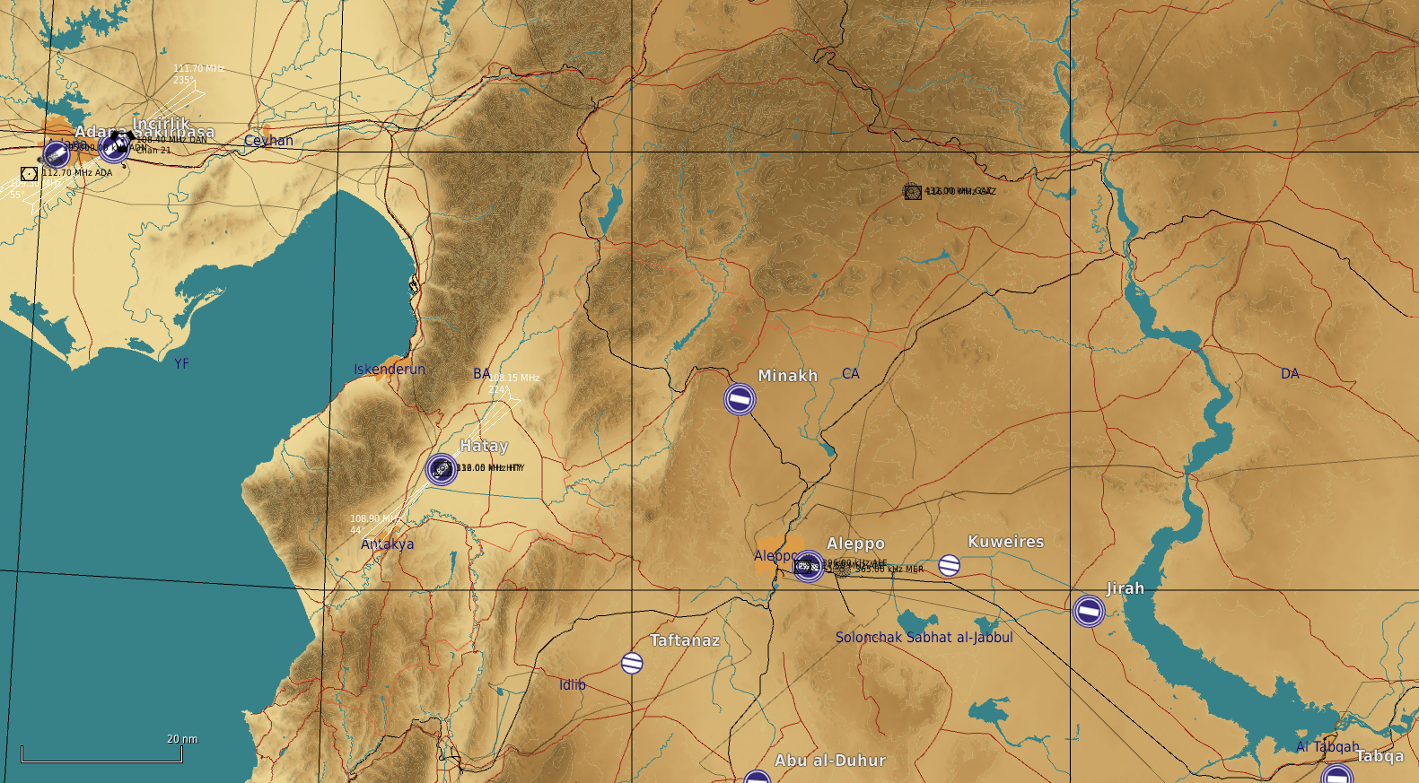
ENEMY SITUATION
IV CORPS
The basic fighting formation in the Syrian army is the division. Here is a representation of a division during an offansive.
The three manuevering brigades (Composed of armor and mechanized forces) are arranged in a «2-front, 1-rear» formation. This arrangement allows for an offensive over a wide front with a lot of firepower, while still having the 3rd brigade close behind. The rear-brigade is ready to support any of the front two brigades in case of high enemy resistance, or to exploit a success breakthrough, and pushing a fresh force forward into the enemy teritorry. The movement of the rear brigade forward may be done between the two front brigades, or directly «through» one of them – depending on terrain, roads and tactical situation.
One of the frontal brigades will be designated as the Main Effort (ME). This brigade will have priority in receiving support from the division-level assets. As shown here, Front Brigade #1 is the ME and is supported by the division’s Rocket-ARTY BN.
Further to the back are the divisional HQ, the logistics BN and an SA-15 BN protecting them.
A second BN of SA-8 will be close to the divisional Rocket-ARTY BN, defending it.
56th Armored Division
11th Mechanized Division
55th Mechanized Division
12th Motorized Division
1st Corps HQ
10th Armored Division
2nd Corps

Slide 3
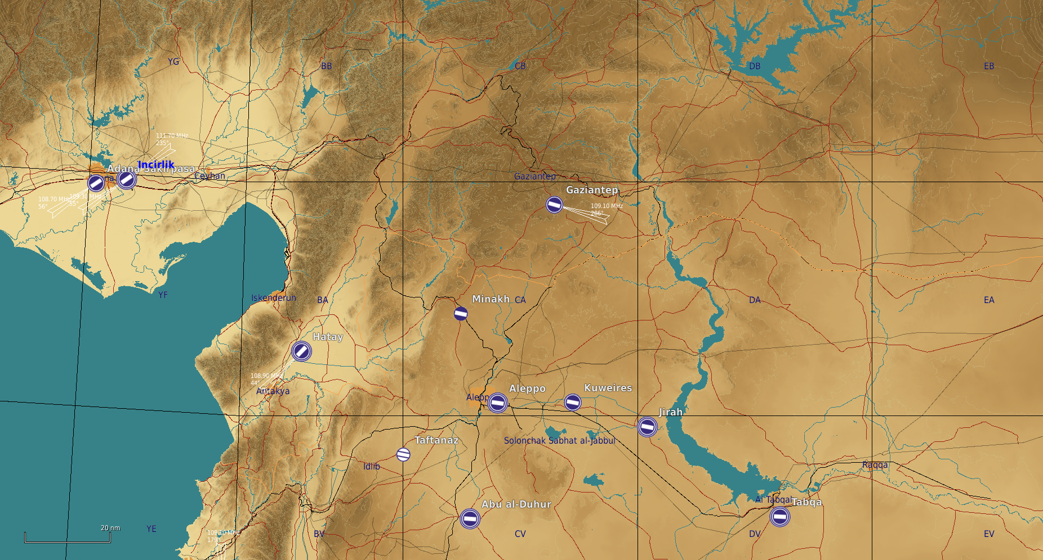
Concept of Operations (CONOPS)
IV CORPS
The basic fighting formation in the Syrian army is the division. Here is a representation of a division during an offansive.
The three manuevering brigades (Composed of armor and mechanized forces) are arranged in a «2-front, 1-rear» formation. This arrangement allows for an offensive over a wide front with a lot of firepower, while still having the 3rd brigade close behind. The rear-brigade is ready to support any of the front two brigades in case of high enemy resistance, or to exploit a success breakthrough, and pushing a fresh force forward into the enemy teritorry. The movement of the rear brigade forward may be done between the two front brigades, or directly «through» one of them – depending on terrain, roads and tactical situation.
One of the frontal brigades will be designated as the Main Effort (ME). This brigade will have priority in receiving support from the division-level assets. As shown here, Front Brigade #1 is the ME and is supported by the division’s Rocket-ARTY BN.
Further to the back are the divisional HQ, the logistics BN and an SA-15 BN protecting them.
A second BN of SA-8 will be close to the divisional Rocket-ARTY BN, defending it.
OBJ B
OBJ A
OBJ C
OBJ E
OBJ D

Slide 4
STAGES
IV CORPS
This phase will be conducted in 4stages:
Stage 1: ( D+1 to D+4 ) Shaping
Main effort: 55th Mechanized division secure OBJ E (HATAY Airfield)
Air Support request to JFACC:
Attrit 105 Rocket Artillery BN, 115th Rocket Artillery BN and 125th Rocket Artillery BN by 75%
Attrit 11th Mechanized Division (IFV`s) by 20 % and Artillery by 50%
Attrit 10th Armor Division MBTs by 25%
Attrit High Value targets in 2nd Corps: 215th Rocket Artillery BN, 225 Rocket Artillery BN, 2nd Corps HQ
Stage 2: (D+4 to D+7)
Main effort: 56th Armored Division: Quick offensive operation to seize objective A
Intention is to neutralize enemy 11th Mechanized Divison, and cut 12th Motorized Divison off from rest of 1st Corps.
Air Support request to JFACC
Attrit 10th Armor Division MBTs by 25%
Deny MBTs from 10th Armor Division from conducting operations into Turkey
Destoy 1st Corp HQ
Attrit 14th Rocket Artillery Regiment by 75%
CAS on request

Slide 5
STAGES
IV CORPS
Stage 3: (D+8 to D+10)
Main Effort: 56th Armored Division: Offensive NORTH to attack and seize objective B.
Intention is to neutralize threat from 12th Motorized Division
Air Support request to JFACC:
Deny MBTs from 10th Armor Division from conducting operations into Turkey
Attrit 10th Armor Division MBTs by 15%
CAS on request
Attrit Artillery BNs in 2nd Corps by 50%
Stage 4: (D+10 to D+12)
Main Effort: Conduct rearm, refuel and prepare for PHASE 2, offensive into Syria.
Air Support request to JFACC:
Deny forces from 1st Corp or 2nd Corps to cross the border into Turkey
Attrit MBT, IFV, Artillery from 1st and 2nd Corps in order to keep pressure on Syrian forces.

